Slide 1


Community development project
On
Child Rights and Education

Slide 2


Kaif islam 12212896 b. tech(cse)
NGO: J. k. Welfare Educational
and Trust

Slide 3
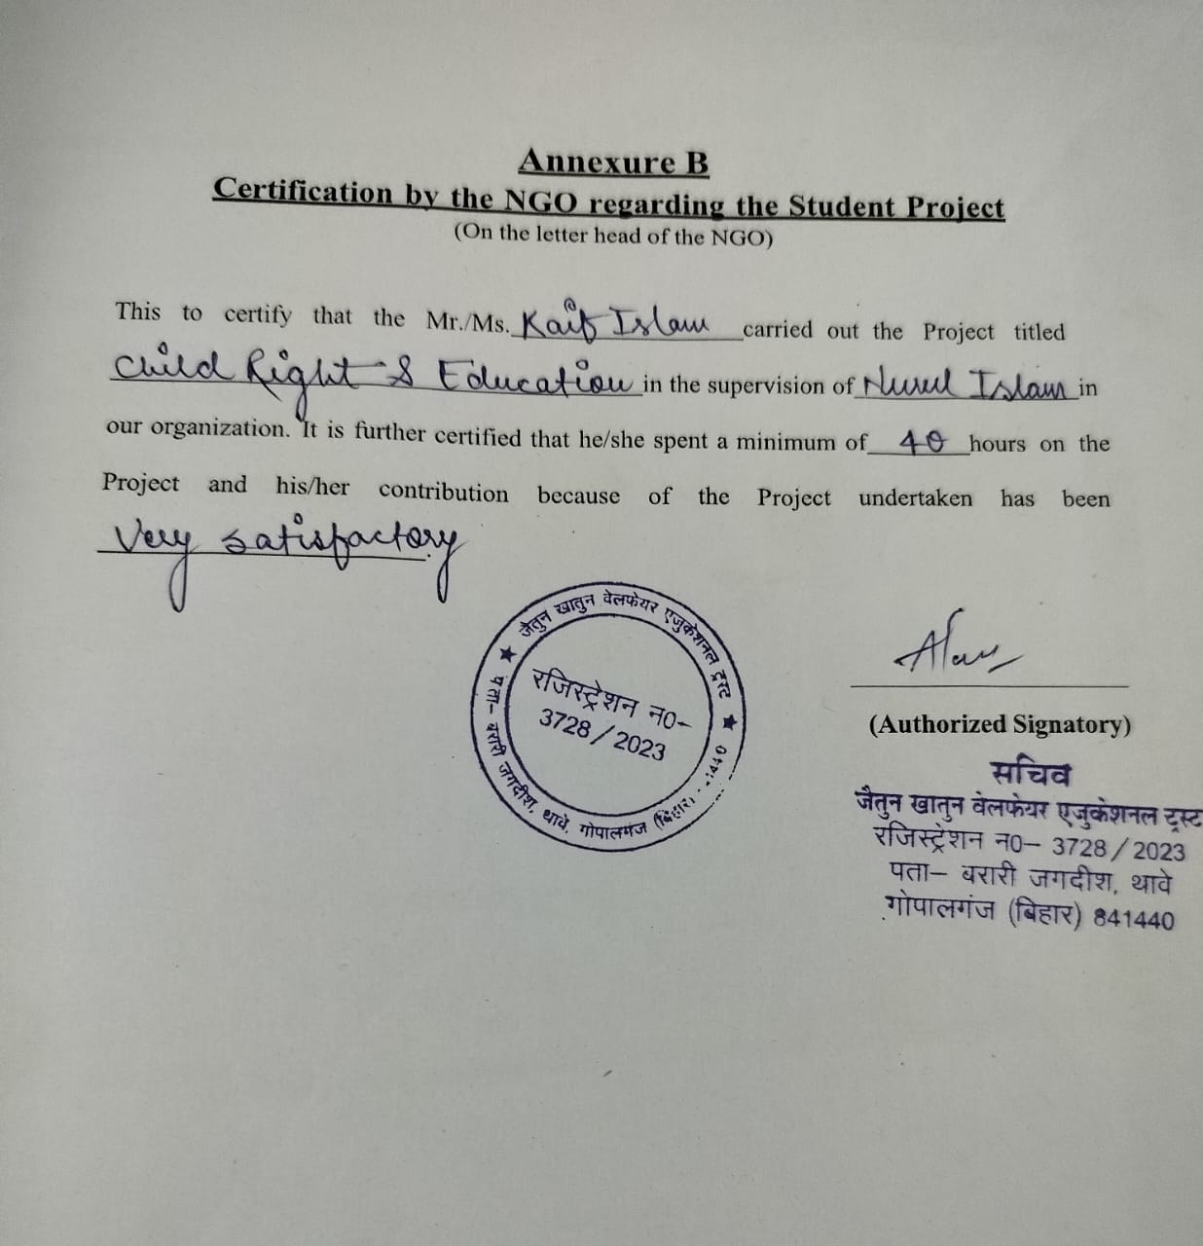
Certificate of the ngo

Slide 4
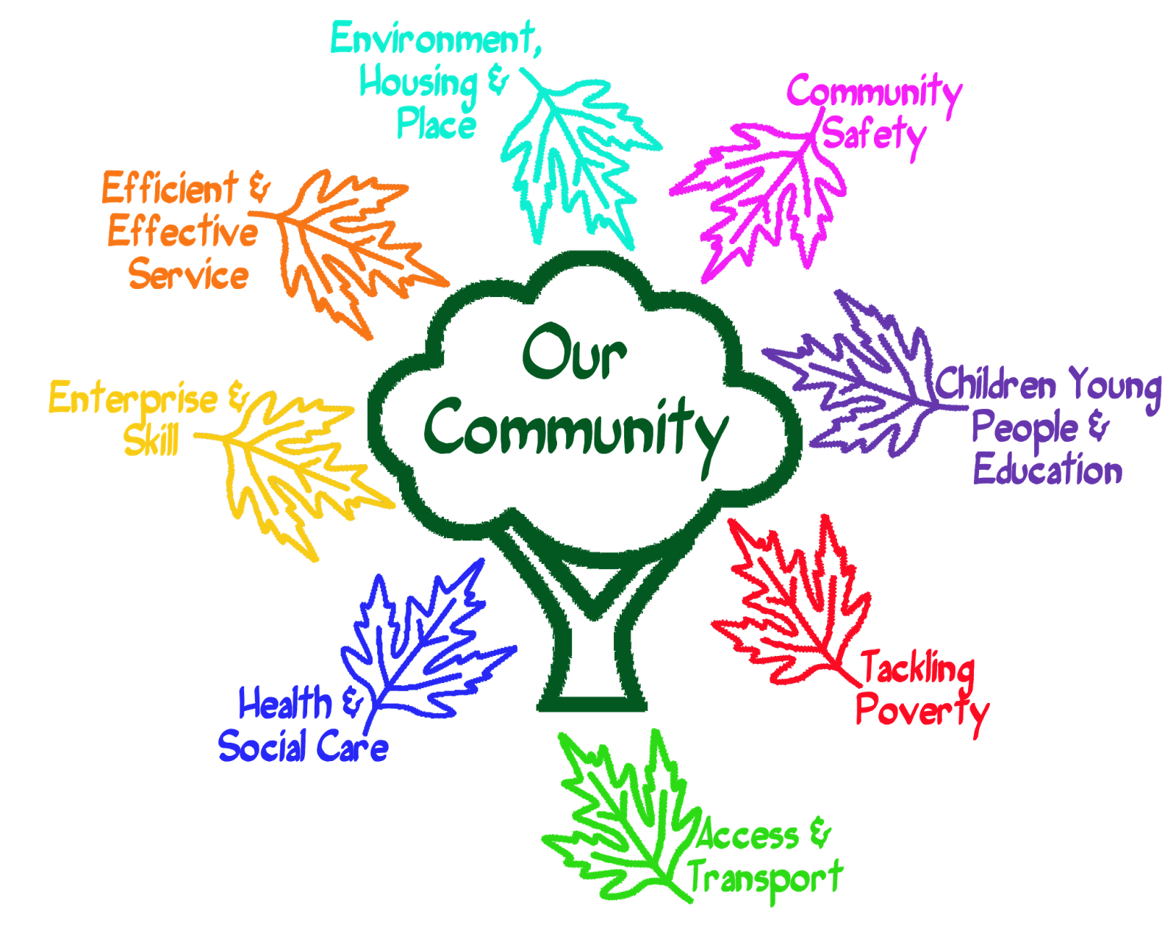
About Us
Welcome to our Community Development Project focused on Child Rights and Education! Our project is driven by the belief that every child deserves a bright and promising future, one where their rights are protected, and their educational journey is nurtured. In this introductory phase, we are excited to outline the key objectives and strategies that will guide our efforts toward creating a positive and lasting impact on the lives of children within our community.
Education stands as a cornerstone in breaking the cycle of poverty and empowering future generations. Our project places a strong emphasis on providing quality education that is accessible to all children, regardless of their background.

Slide 5


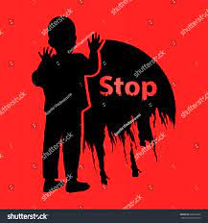



The Problems
Age Inappropriate Work
Lack of Education
Lack of Teacher Training
Exploitative Conditions
Long Working Hours
Children are engaged in work that is not suitable for their age and developmental stage.
Children are prevented from accessing proper education due to work commitments.
lack proper training and professional development opportunities. This can result in ineffective teaching methods and a reduced quality of education for students.
Children work in hazardous, exploitative, or unsafe conditions that threaten their health and well-being.
Children are made to work long hours, depriving them of adequate rest and leisure time.

Slide 6





Solution
Education and Awareness: Projects that prioritize education as a key strategy can help children transition from work to school. Raising awareness about the importance of education and the dangers of child labor within communities is crucial.
Child Protection: Ensuring the safety and well-being of children is paramount. Projects should focus on removing children from hazardous or exploitative work environments.
Positive Outcomes
Leads
Awareness
The success of a child labor project should be measured not only by the reduction in child labor but also by broader positive outcomes, such as increased enrollment in schools, improved overall child well-being, and poverty reduction.
Spreading verified leads to every life is compulsory
Spreading Awareness among everyone

Slide 7
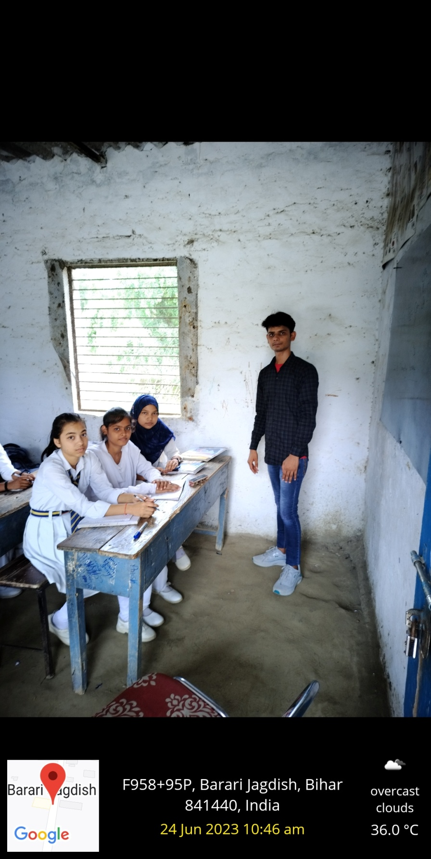
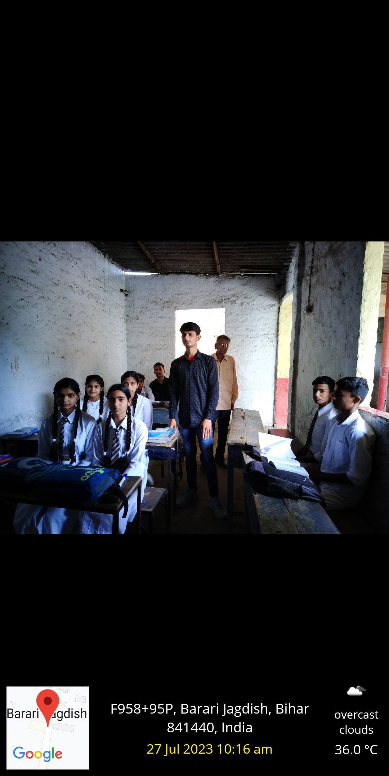
Teaching Students

Slide 8
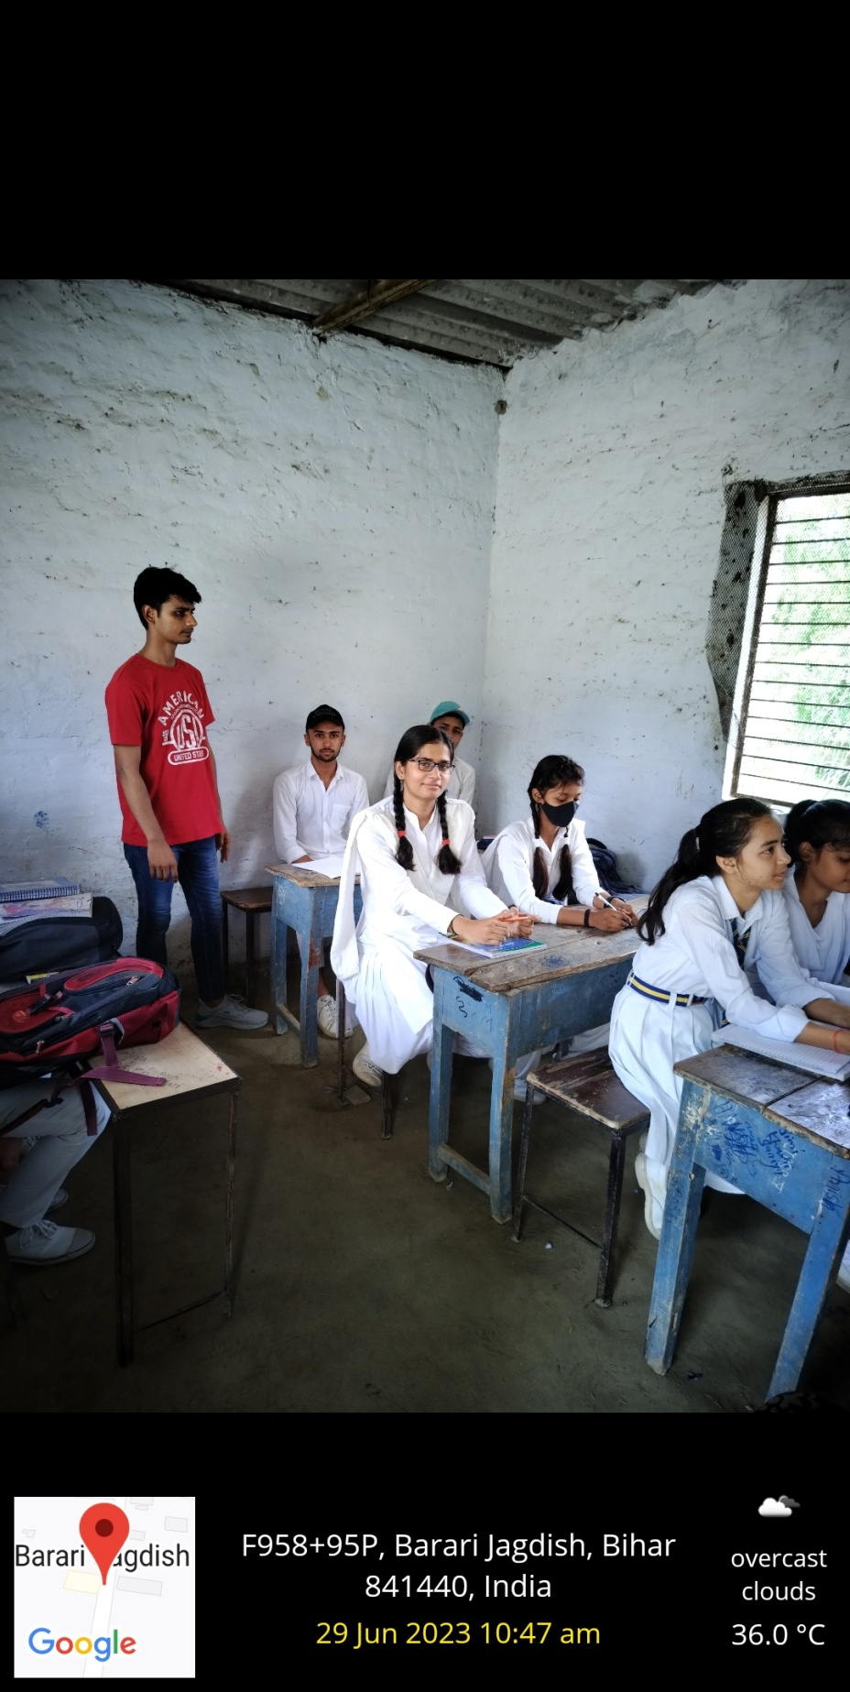
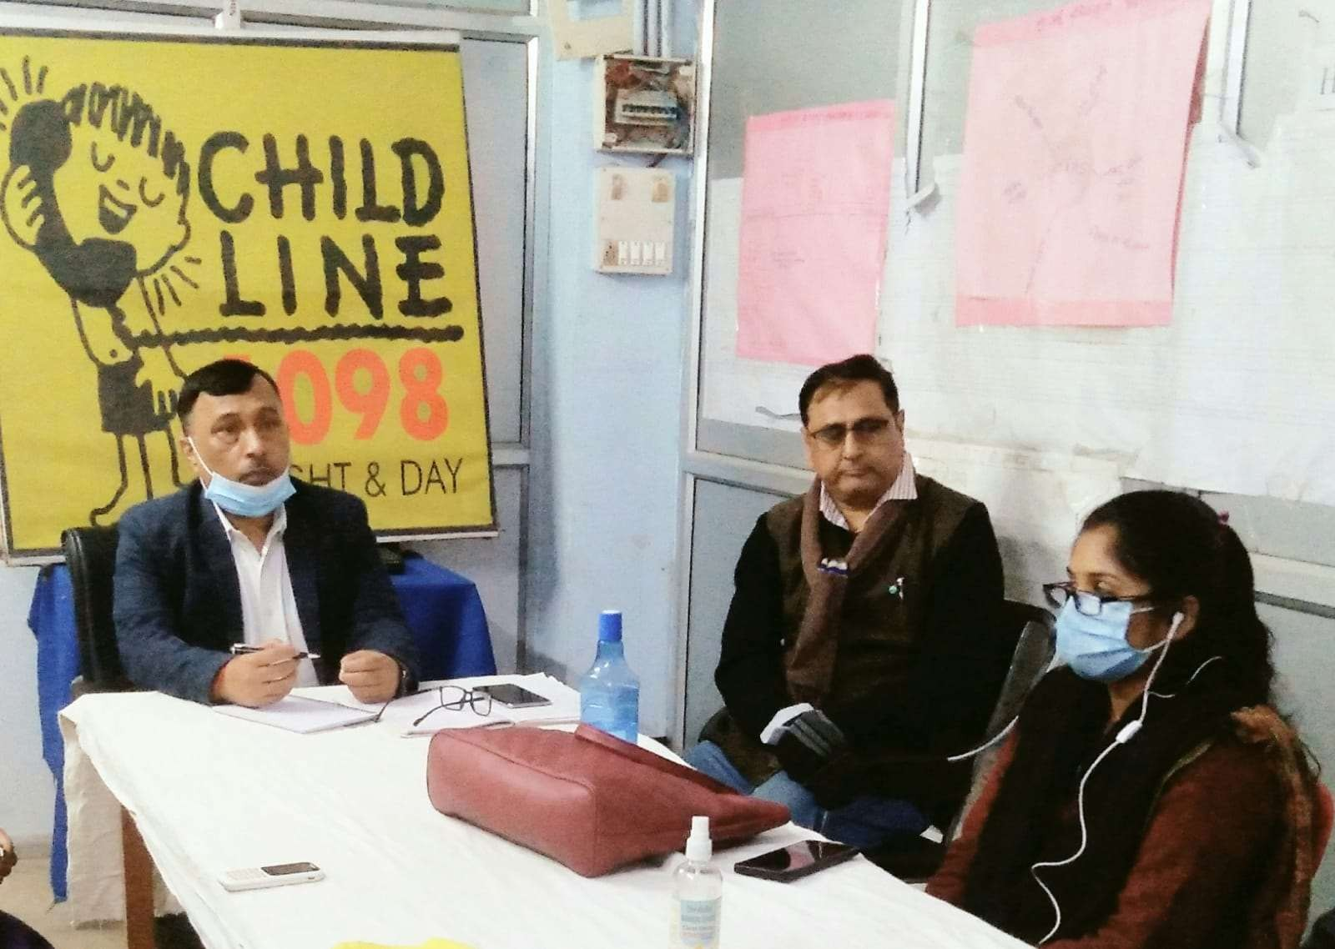
Project activity

Slide 9
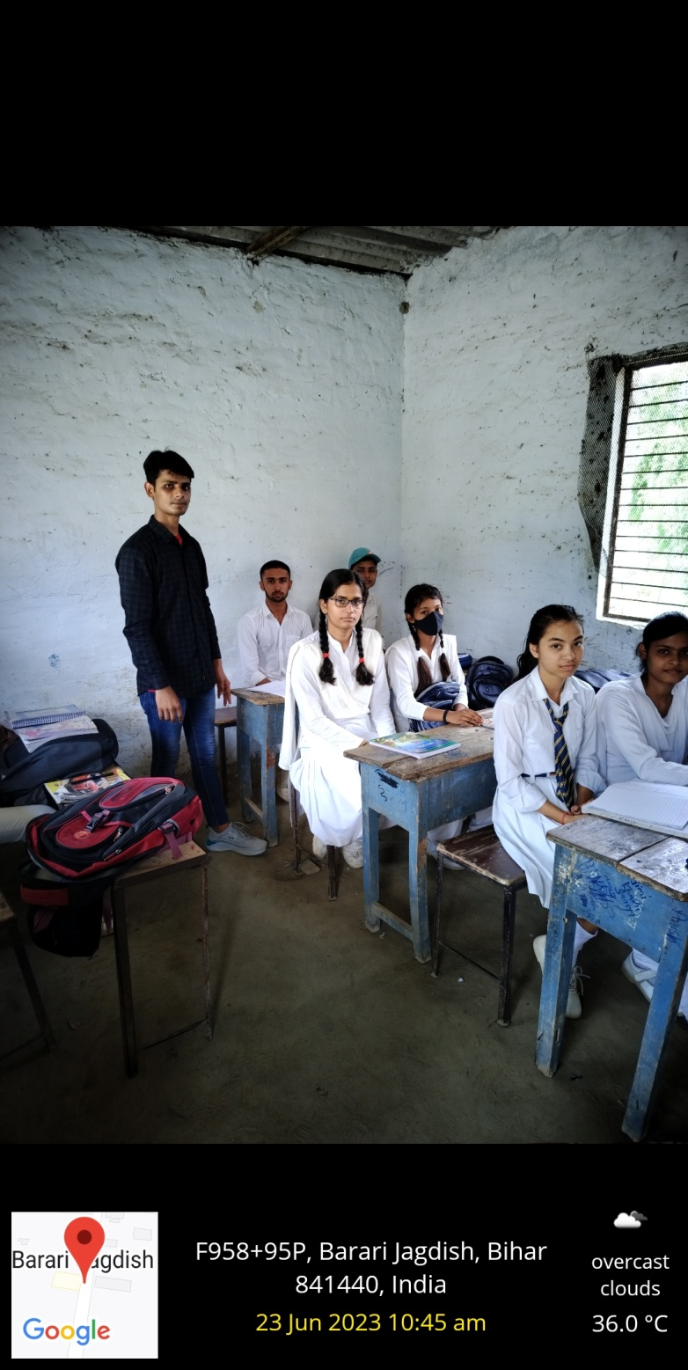
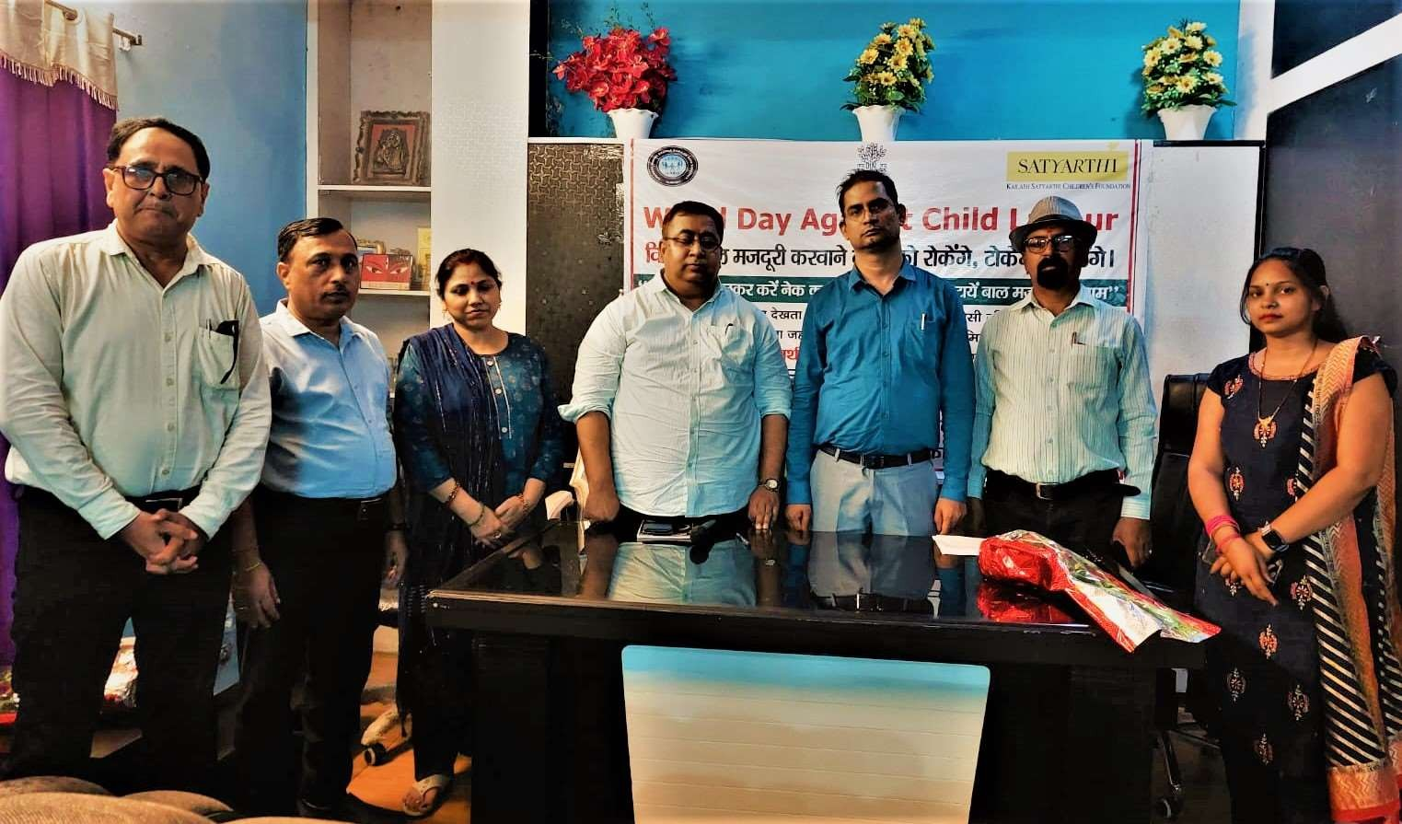
Project activity

Slide 10

Thank yoU

